Slide 1
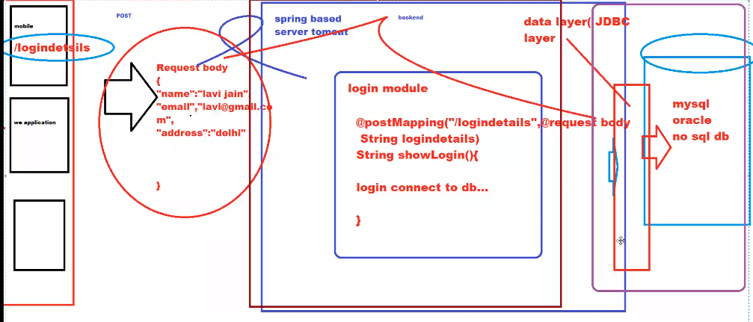

Slide 2
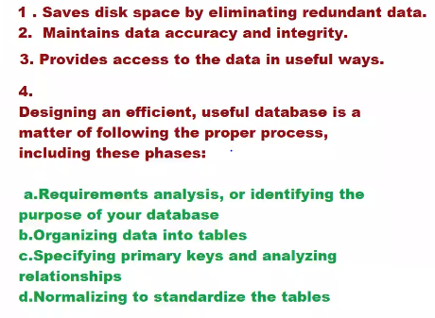
Rule 1: Information Rule. ...
Rule 2: Guaranteed Access Rule. ...
Rule 3: Systematic Treatment of NULL Values. ...
Rule 4: Active Online Catalog. ...
Rule 5: Comprehensive Data Sub-Language Rule. ...
Rule 6: View Updating Rule. ...
Rule 7: High-Level Insert, Update, and Delete Rule. ...
Rule 8: Physical Data Independence.

Slide 3
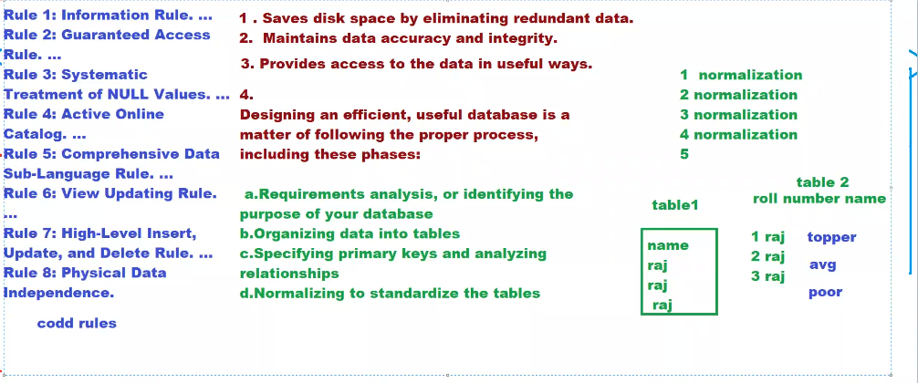

Slide 4
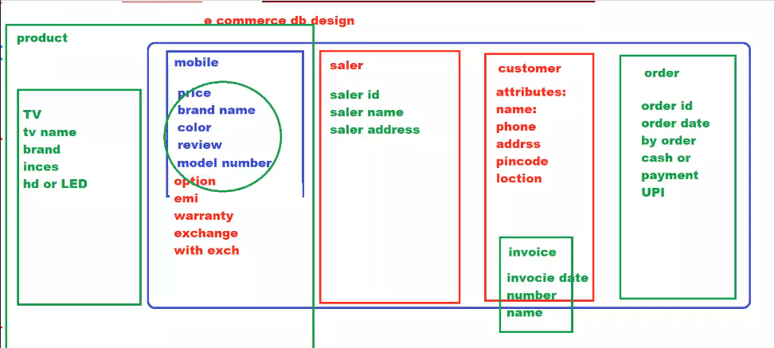

Slide 5
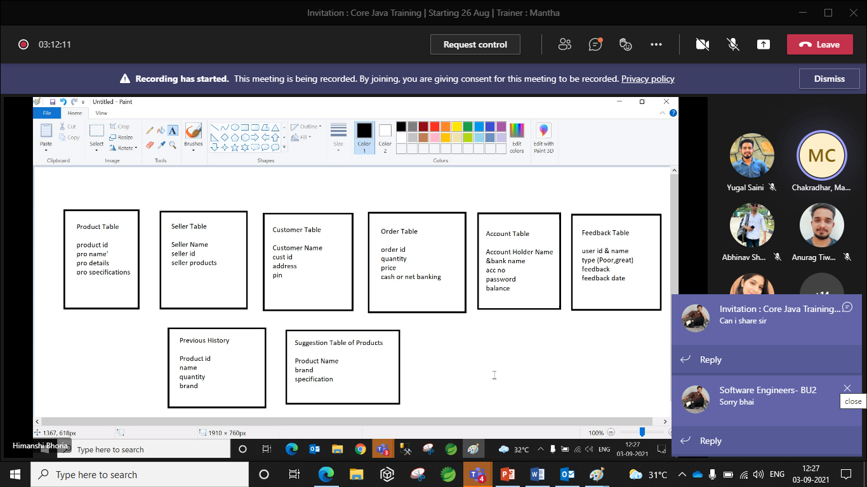

Slide 6
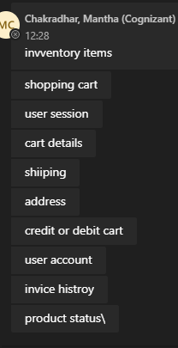
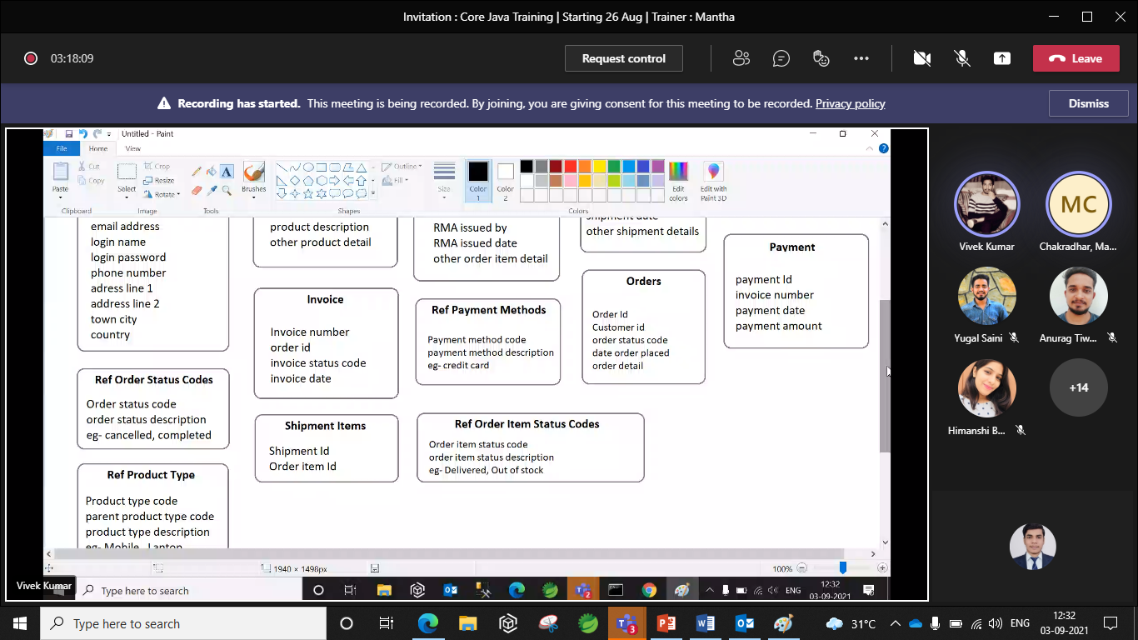


Slide 7
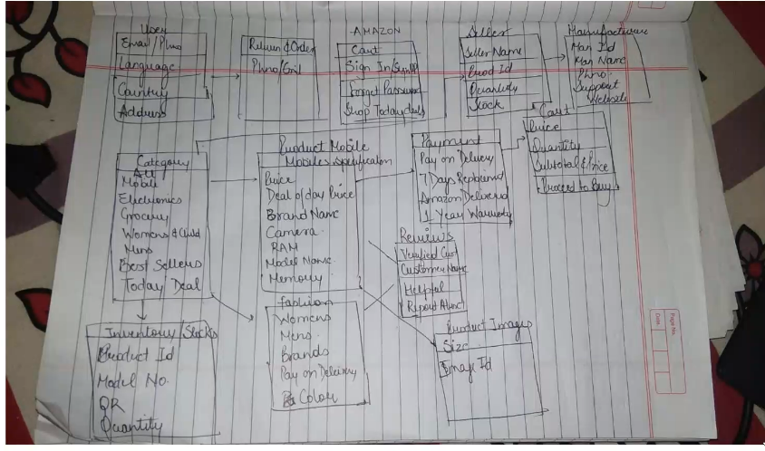

Slide 8
